Slide 1
Logistic regression – Predict stock movement
Motivation: Binary logistic regression deals with situations in which the outcome for a dependent variable can have two possible type. We can use Mahout logistic regression to forecast what is the next action (Buy versus SELL) based on training input. The assumption is that the BUY/SELL action depends on a combination of market dependent inputs (Open, Close, High) as predictor.
Algorithm:
Applied JAVA code (APP.java) to create action (BUY/SELL) column. If the close price of the current timeline is greater previous timeline, Action = SELL, otherwise, Action = Buy
Trained the file using a logistic regression from the mahout command line
Applied the generated model against test of data
Result:
The first parameter is AUC (Area Under the Curve). This parameter is the probability of the model that classifies the data correctly. The AUC tells us the higher the value between 0 and 1, the fewer false positives we have. AUC = 0.7, not high enough for good model.
The 2nd parameter is the confusion matrix . This parameter tell us that the model performs well in 41 out of 66 test cases.

Slide 2
Time-Series Analysis: Forecasting multistep ahead base on GARCH model and calculate VAR
Motivation: Real world financial time series has property called volatility clustering; that is periods of relative calm are interrupted by bursts of volatility. An extreme market movement might represent a significant downside risk to the security portfolio of an investor. Using RHadoop ecosystem to forecast the future volatility and calculate Value at Risk (VAR) can help investor to prepared for losses arising from natural or man-made catastrophes, even of a magnitude not experienced before.
Algorithm:
Used PIG and Python script to pre-process the raw data (AAPL) then load it into Rstudio
Applied R code (TimeSeriesAnalysis.R). Calculated the return in percentage.
Applied GARCH modeling to forecast the future volatility and calculate VAR
Applied Extreme Value Theory (EVT) to fit a GPD distribution to the tails
Result:
Calculated Forecast for the volatility and Value at Risk (VaR) at 99% confidence level (Loss is expected to be exceeded only 1% of the time). In this example, AAPL (2008 – 2009), we calculated that 99% probability the monthly return is above 4%.
Used statistical hypothesis tests (Ljung-Box) for autocorrelation in squared returns (p value ~0, reject the null hypothesis of no autocorrelations in the squared returns at 1% significance level). GARCH model should be employed in modeling the return timeseries.

Slide 3
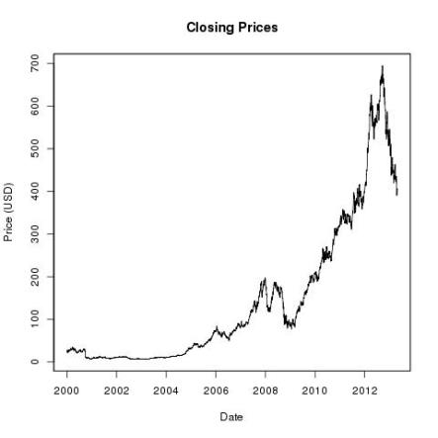
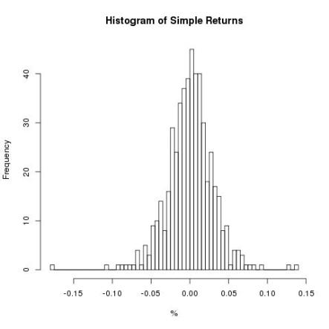
Time-Series Analysis: Forecasting multistep ahead base on GARCH model and calculate VAR

Slide 4
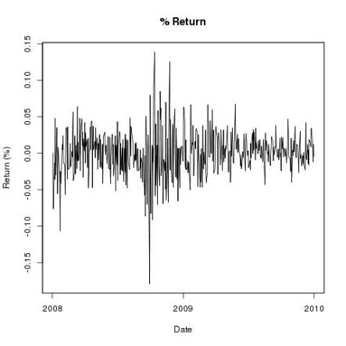
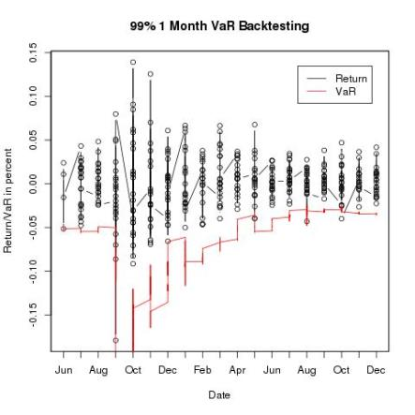
Time-Series Analysis: Forecasting multistep ahead base on GARCH model and calculate VAR

Slide 5
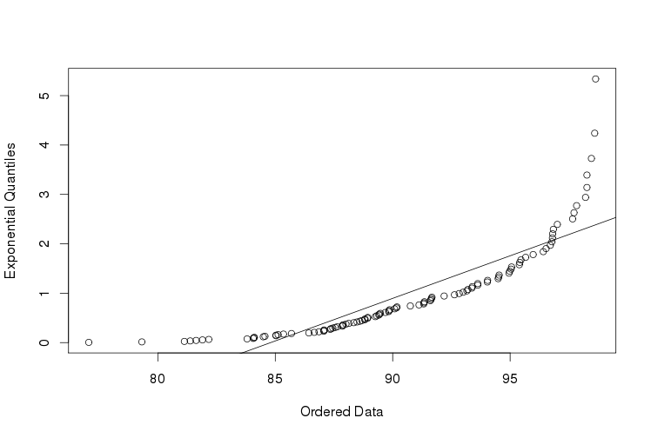
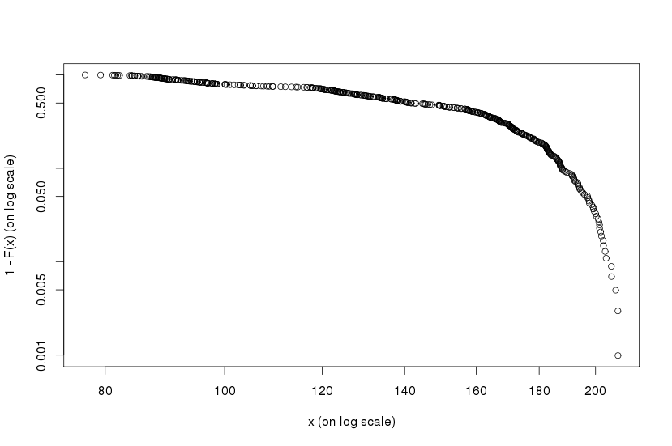
Time-Series Analysis: Forecasting multistep ahead base on GARCH model and calculate VAR
Tail of the AAPL % Return data
Quantile-quantile plot

